Slide 1
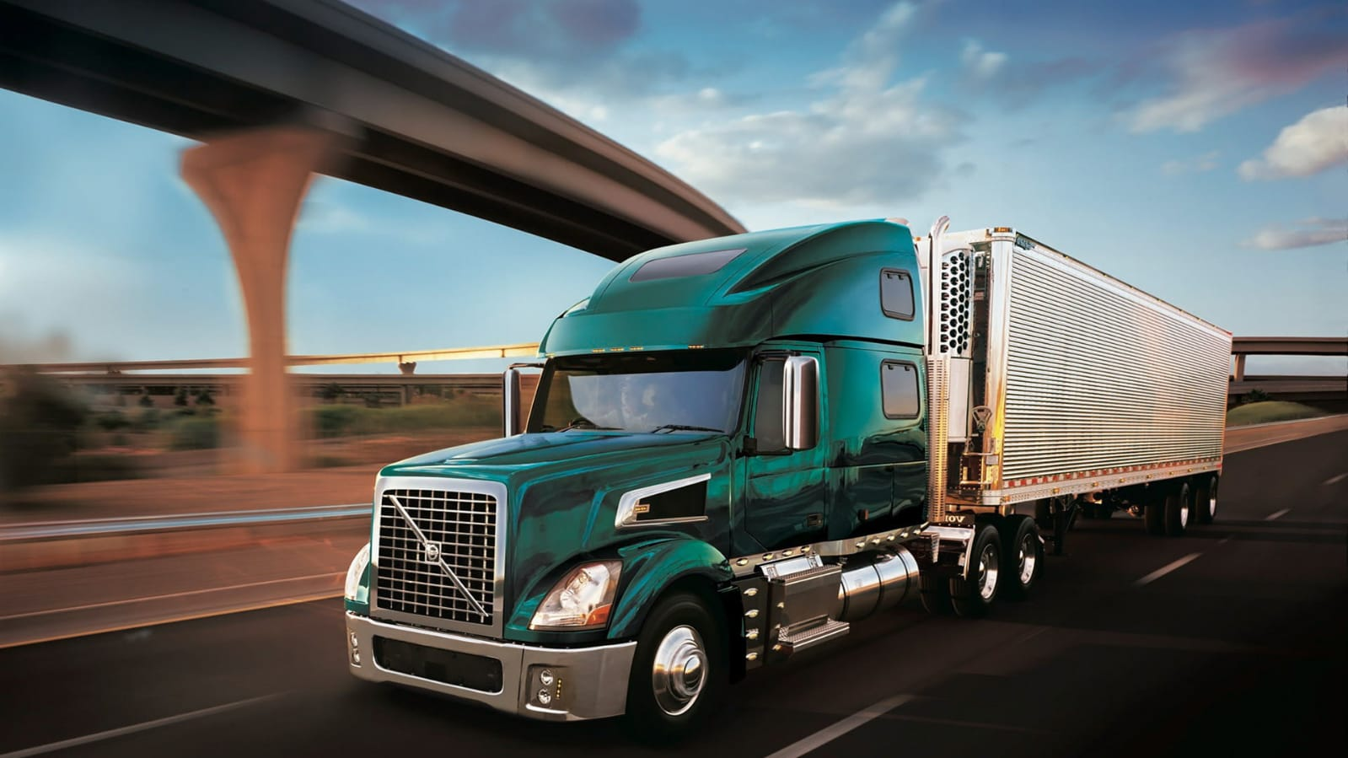
CARGO MANAGEMENT SYSTEM

Slide 2
GROUP SIZE
DIV | ROLL NO. | NAME
B | 67 | MANSURI JISHAN

Slide 3
Acknowledgement
It is our great pleasure to present you the project of “CARGO MANAGEMENT SYSTEM”. This project is part of our syllabus in Semester- 6, Third Year of BCA.
We would like to express thanks to our honorable Directors for their valuable guidance and motivation.
Then we would like to thank our faculties who have played vital role in the partial completion of this project.
We are also very thankful to the owner of the company for his great support.

Slide 4
INDEX
Sr. No | Topic | Page No
1. | Project Profile | 1
 | 1.1 Group Size | 2
 | 1.2 Acknowledgement | 3
 | 1.3 Project Description | 5
 | 1.4 Company Description | 6
 | 1.5 Existing System | 7
 | 1.6 Proposed System | 8
 | 1.7 Tools & Technologies | 9
2. | Screen Layouts | 10
 | 2.1 Admin Side | 11 – 98
 | 2.2 Employee Side | 99 – 139
 | 2.3 Visitor Side | 140 - 154
 | 2.4 Customer Side | 155 - 184
3. | Report Layouts | 185 - 197
4. | Conclusion | 198
5 | Bibliography | 199

Slide 5
Project Description
The cargo management system is the solution of a transport service.
Which includes the facility of Transportation services at national level.
The purpose of this project is made easiest way to interact with customers directly.
Through the cargo management system we can easily manage our Business.
After that we can Spread our business at high level. By providing better service we can get Positive review of customer.
By giving feedback customer can suggest us best idea for making our business better.

Slide 6
Company Description
Shubha-laxmi cargo movers in ahmedabad is one of the leading businesses in the transporters for all india.
Established in the year 2000 shubhalaxmi cargo movers in ahmedabad is a top player in the category transporter for all india in ahmedabad.
Shubha-laxmi cargo movers in narol has a wide range of products and services to requirement of their customer.

Slide 7
Existing System
The current working nature of the company is completely offline which is the biggest drawback to survive in this industry.
Customer have to give orders only by visiting company.
Customer have to book any service only by going to the company

Slide 8
Proposed System
We will develop a dynamic website that will allow the company to expand its targeted audience and deals with the customers.
The company will have an effective online presence which will eventually lead to easier access for larger audience.
The customers will be able to easily book a service as an order online.
Feedback and communication will help the company to reduce advertising cost and maximize rich.

Slide 9
Tools And Technology
HTML5
CSS3
JavaScriptES6
Python – 3.11.3
Django Framework - 4.2.2
Front End
Back End
My SQL Version 8.0.33
Other Tools
Xampp version 8.2.4
Microsoft visual studio code 1.79.2
Microsoft visio 2019 (Diagram)
Microsoft word 2007 (Documentation)
Microsoft PowerPoint 2007 (PPT)

Slide 10
SCREEN LAYOUTS :

Slide 11
ADMIN SIDE :

Slide 12
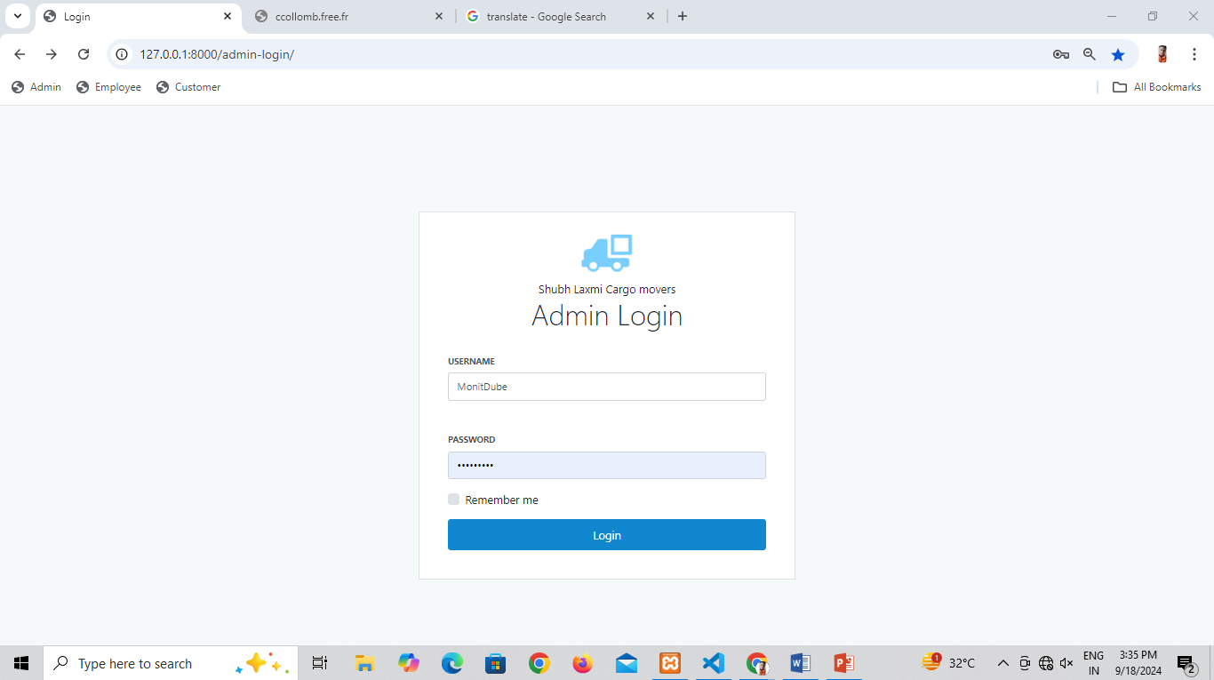

Slide 13
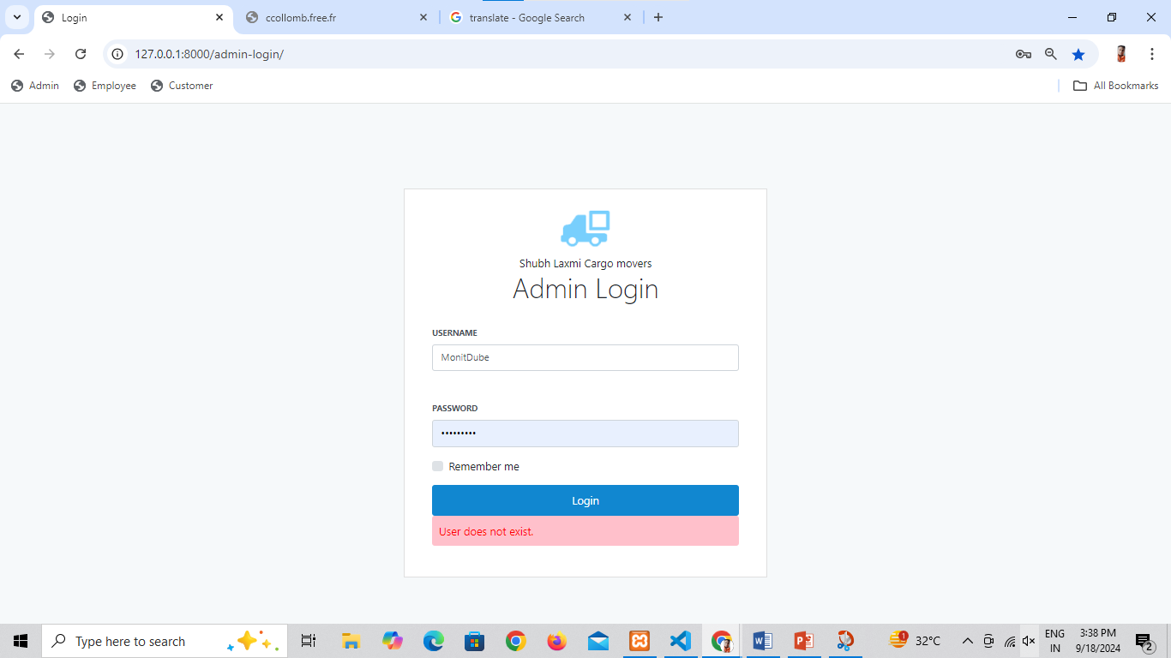

Slide 14

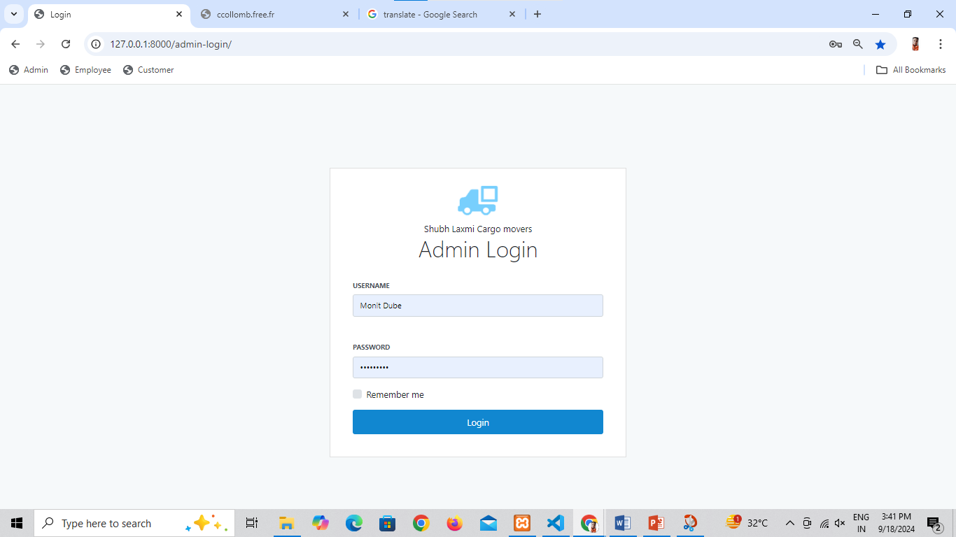

Slide 15
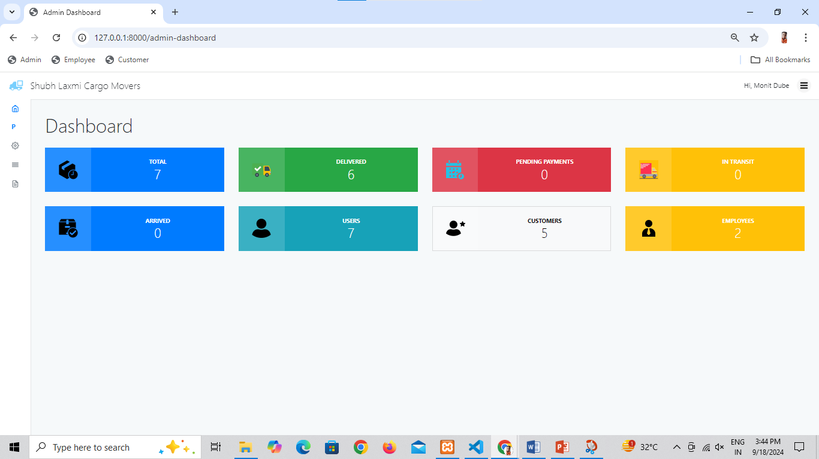

Slide 16
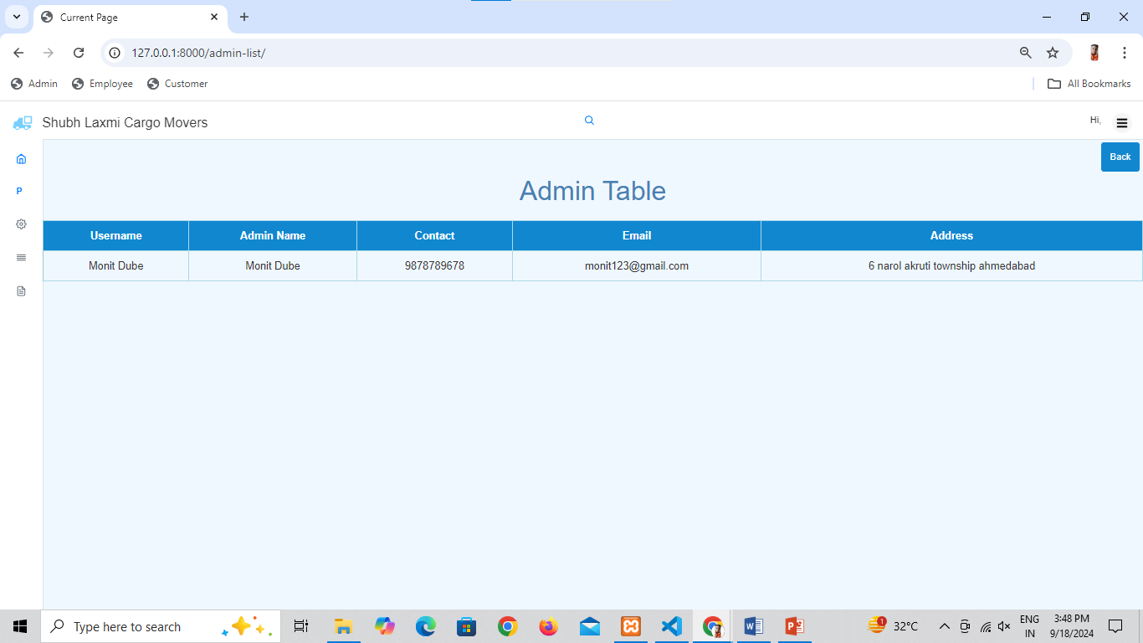

Slide 17
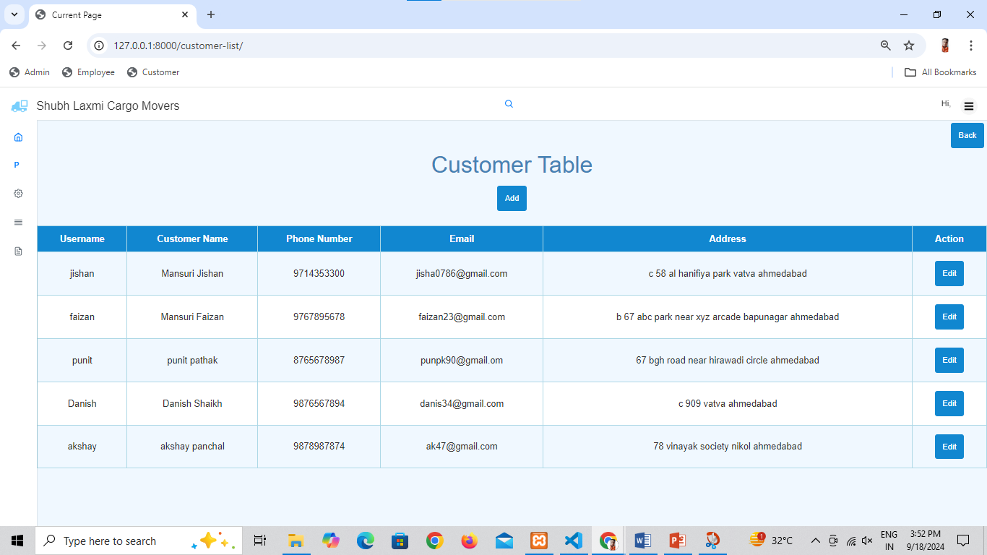

Slide 18
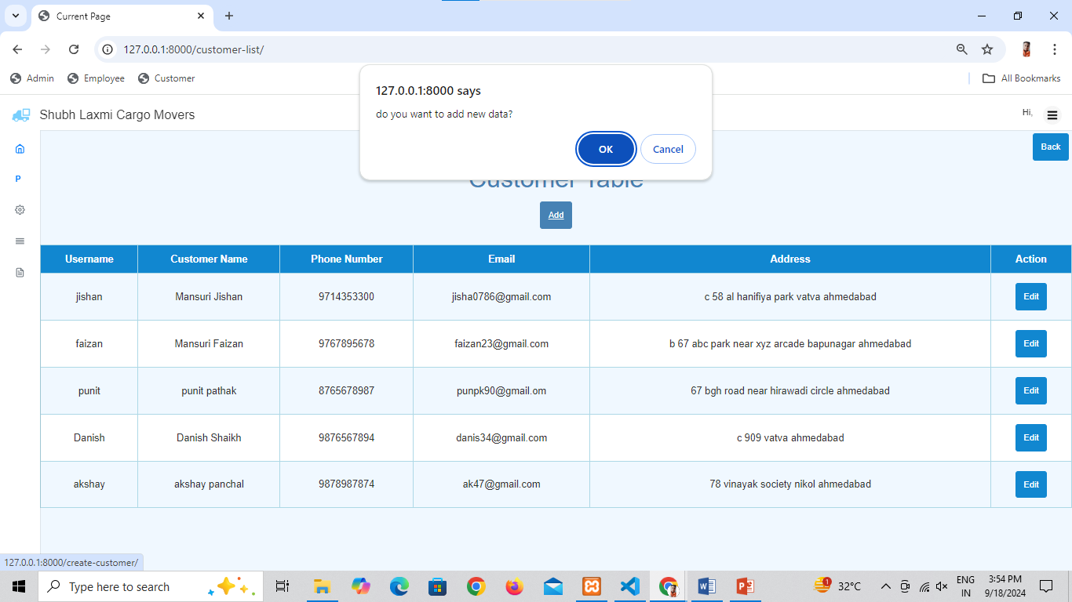

Slide 19
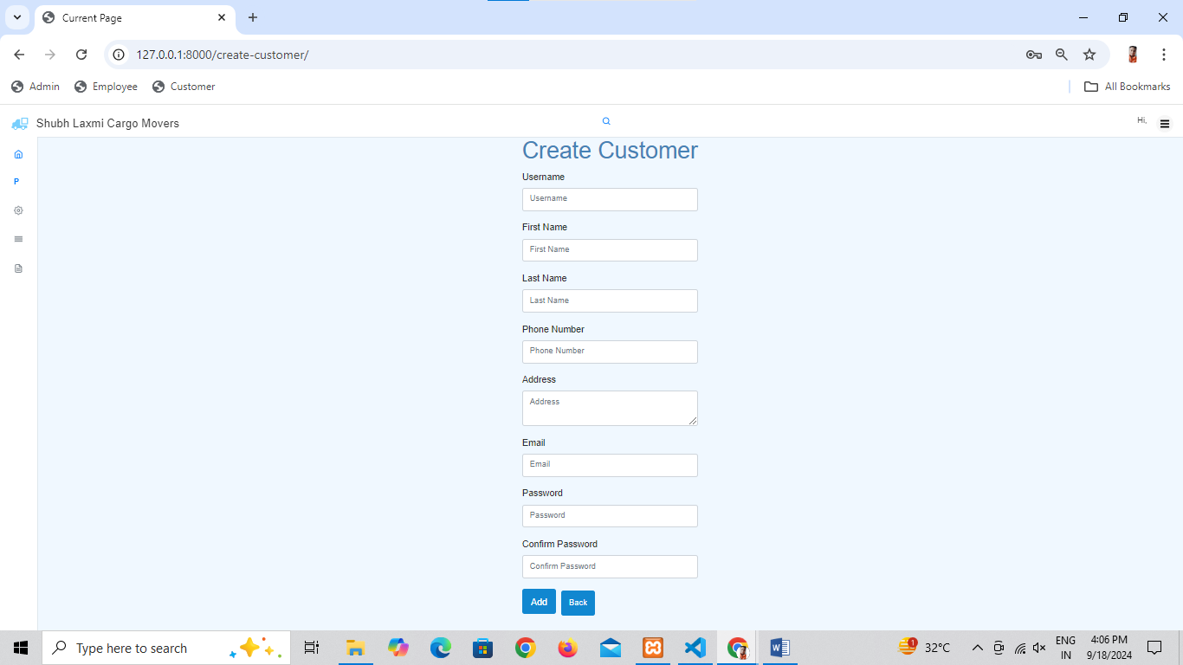

Slide 20
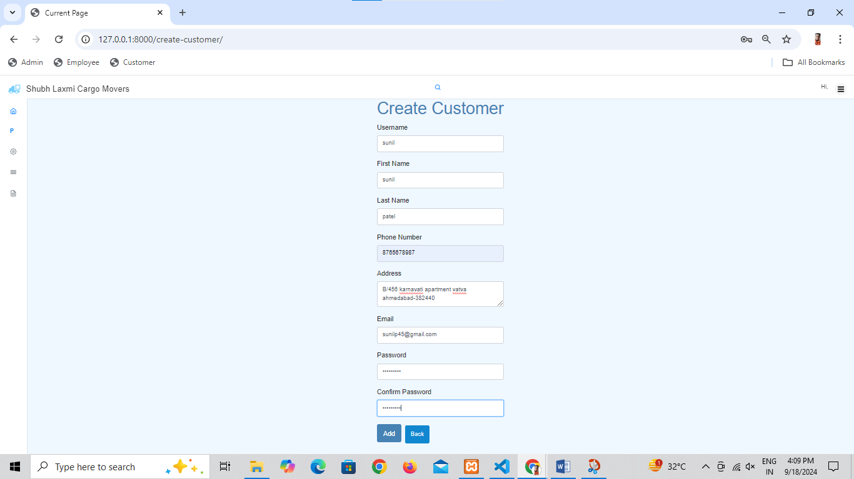

Slide 21
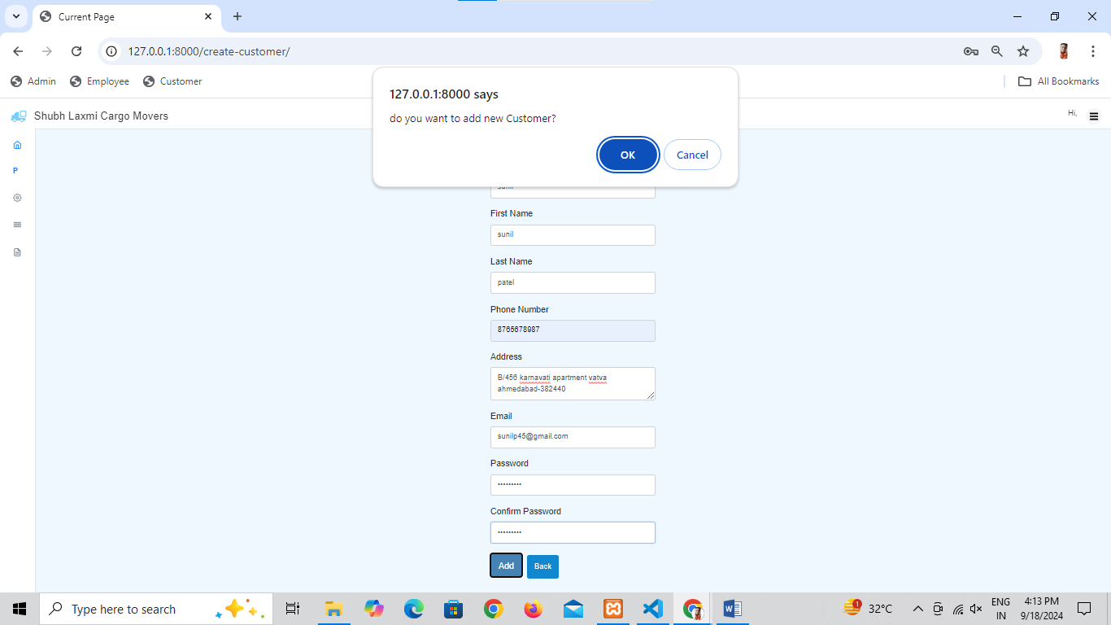

Slide 22
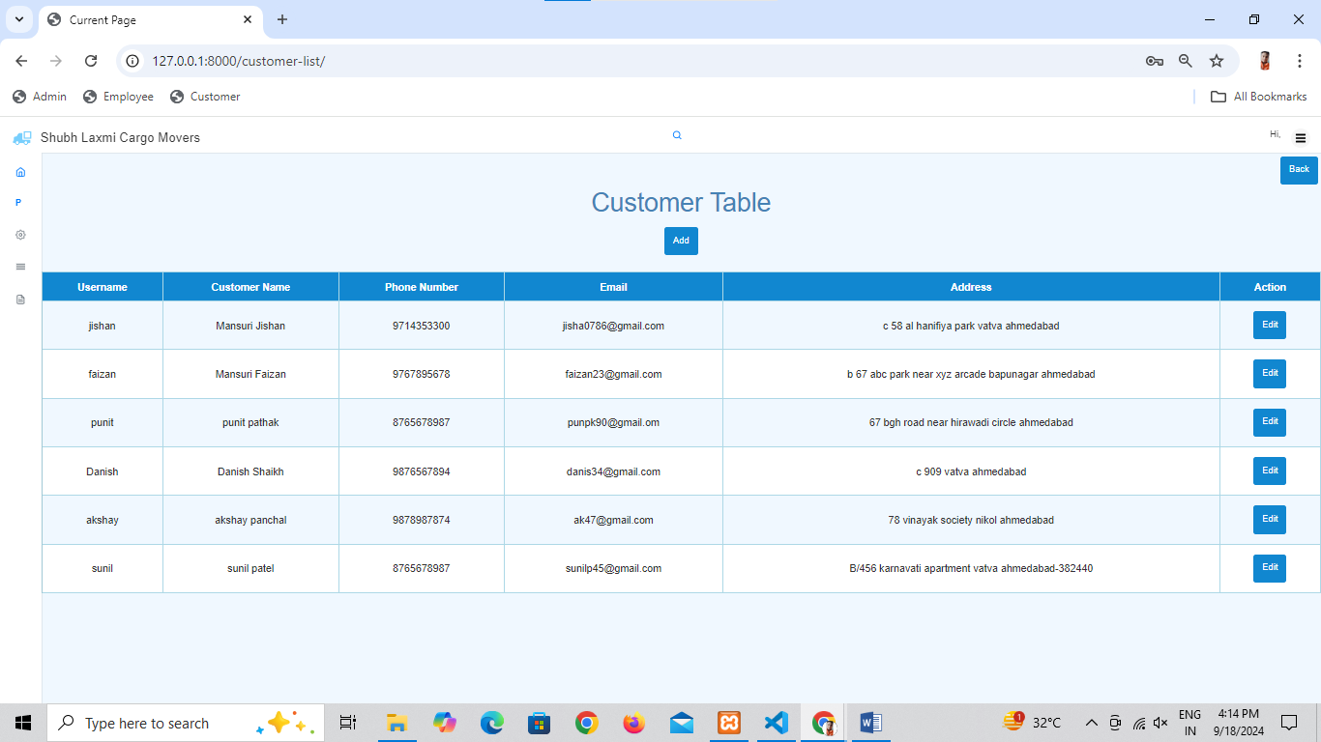

Slide 24
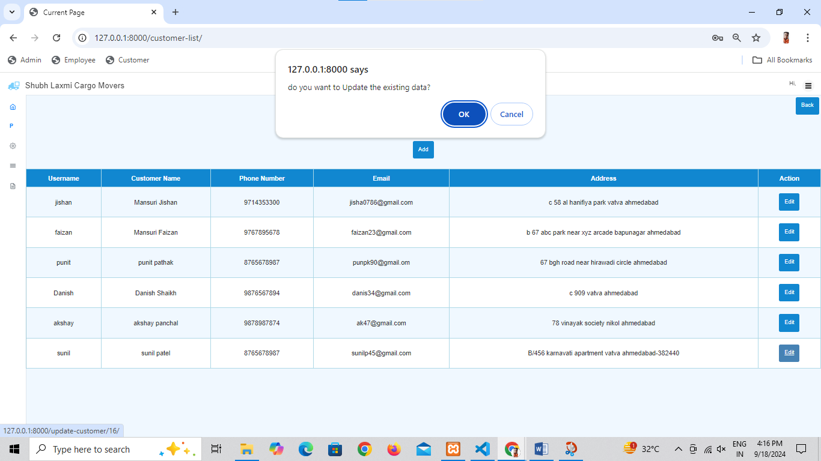

Slide 25
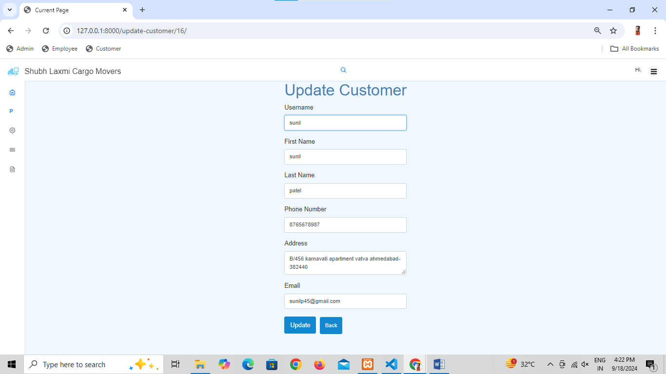

Slide 26


Slide 27
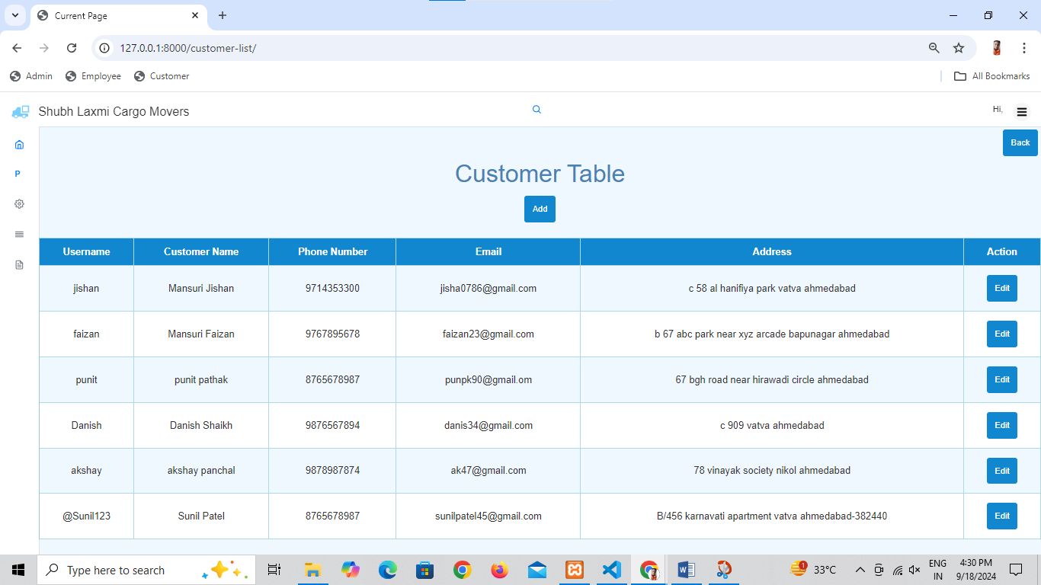

Slide 28
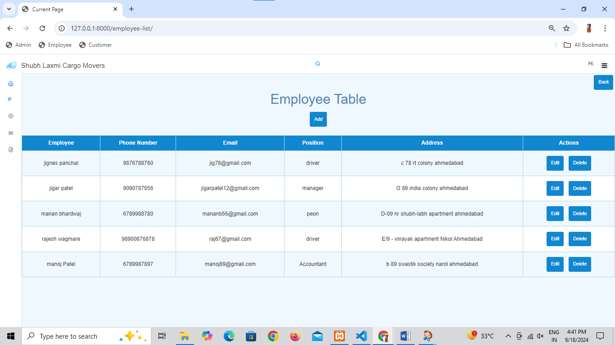

Slide 29
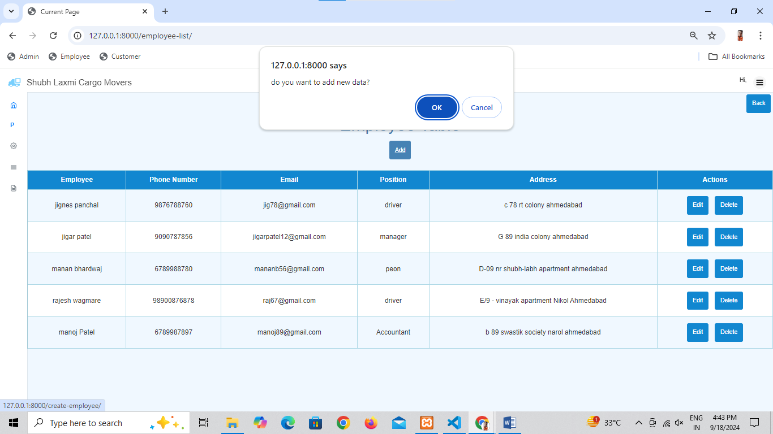

Slide 30
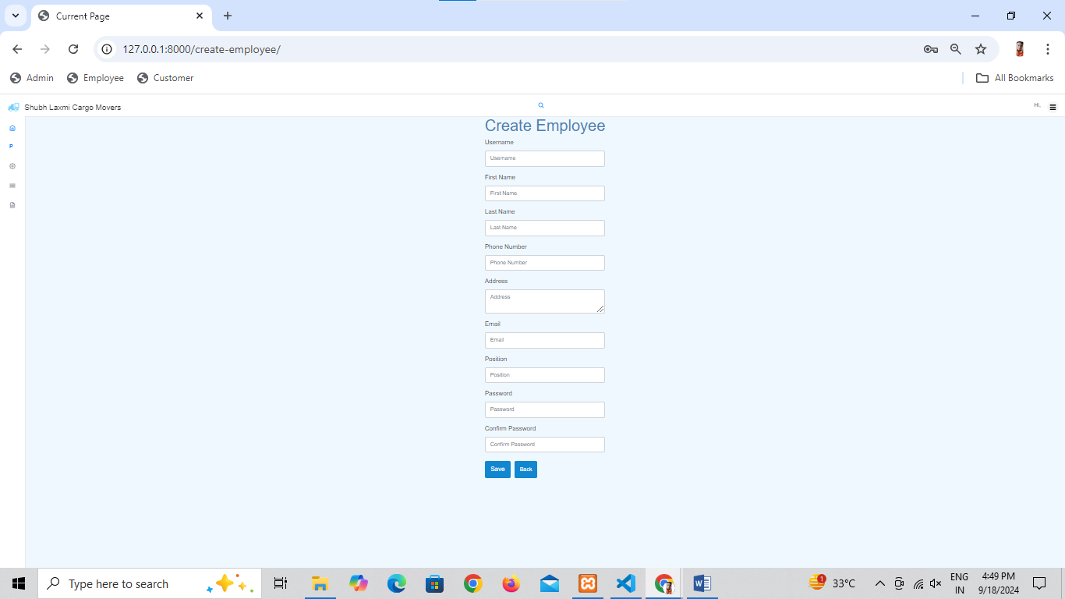

Slide 31
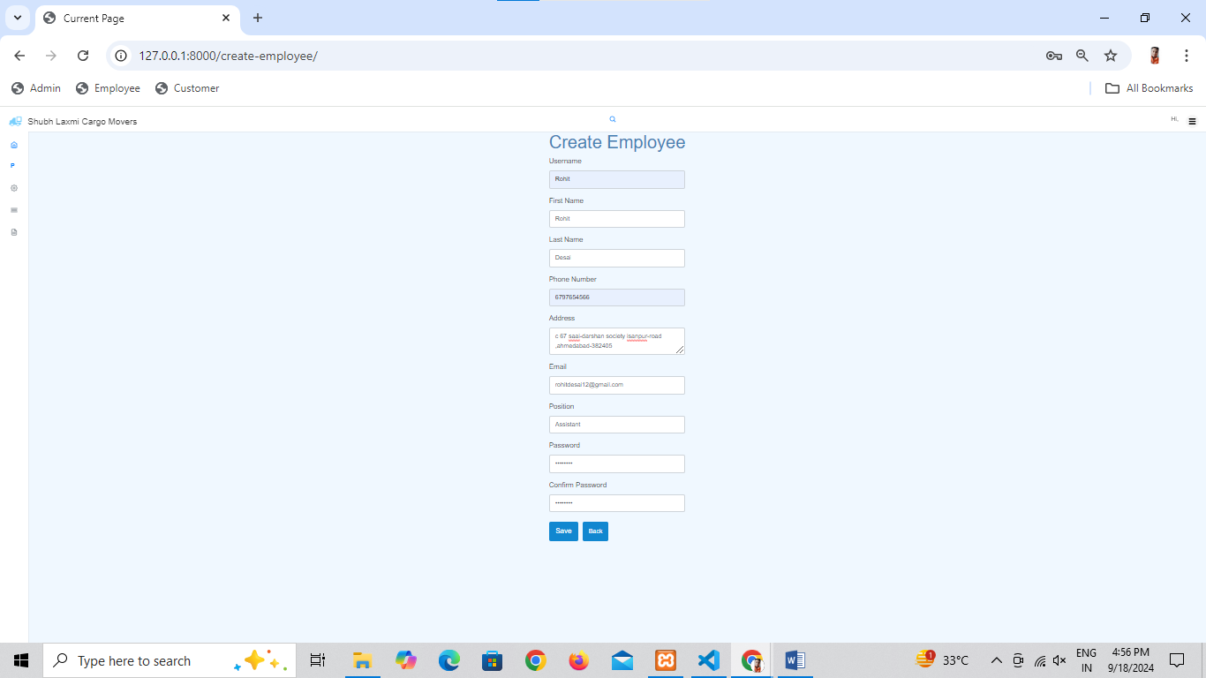

Slide 32
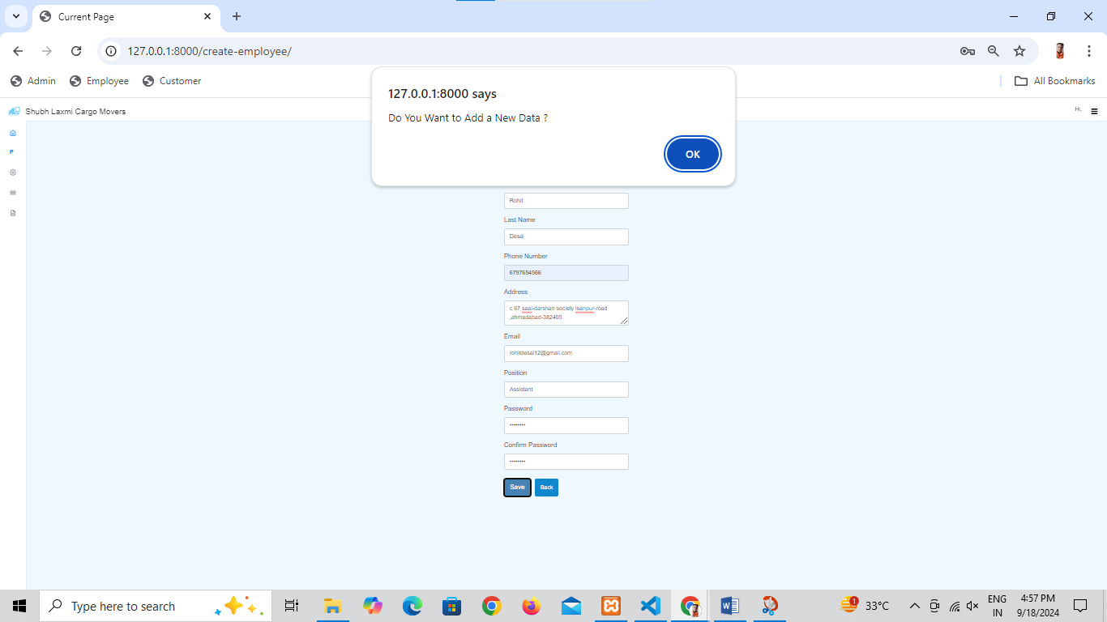

Slide 33
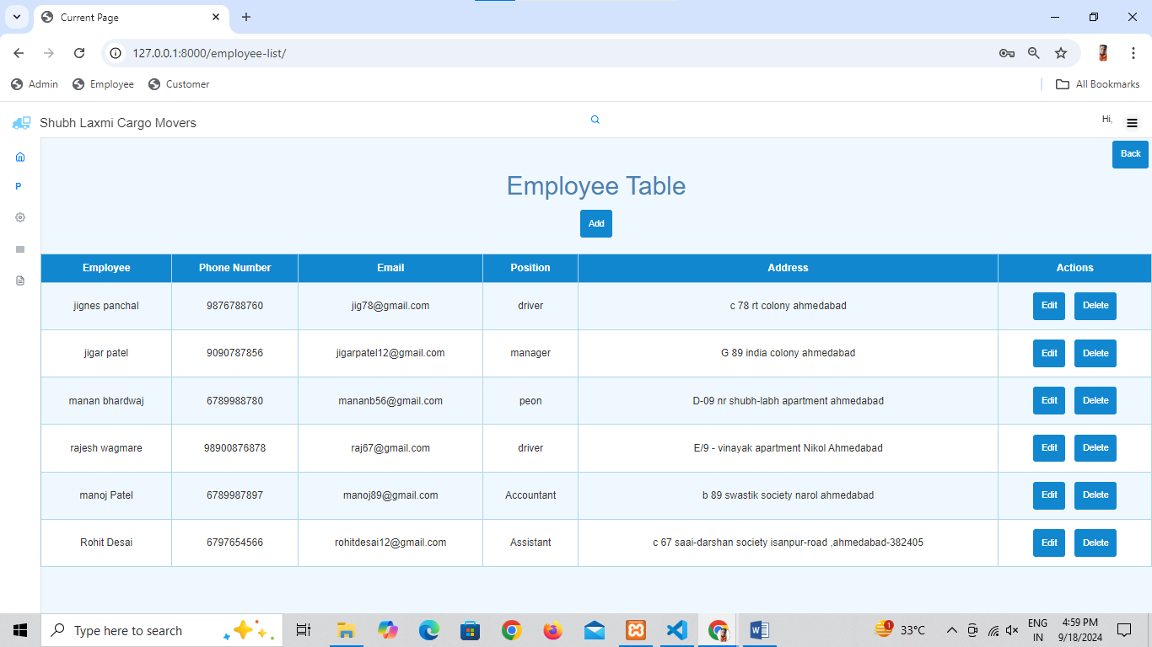

Slide 34
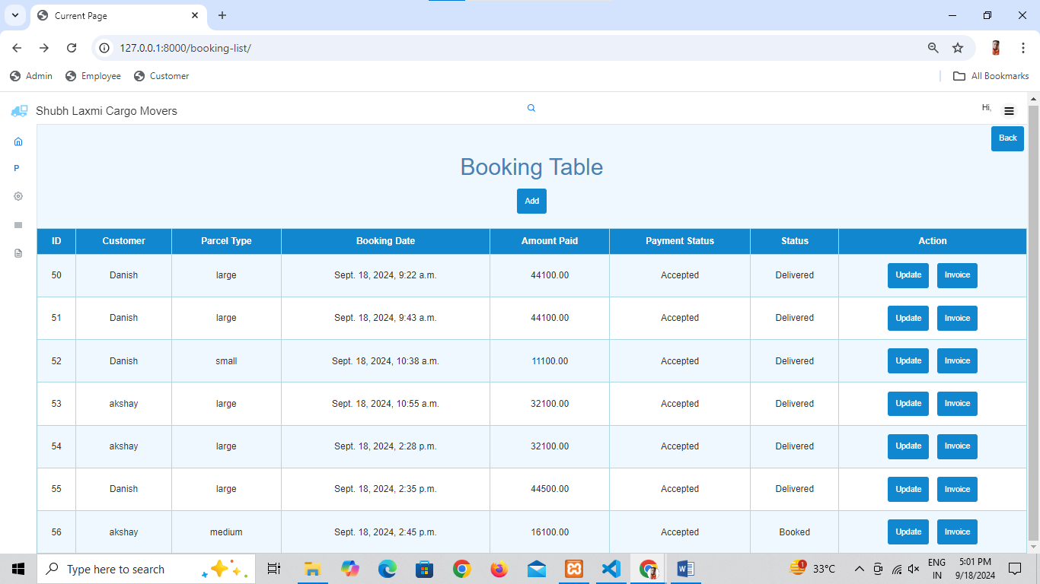

Slide 36
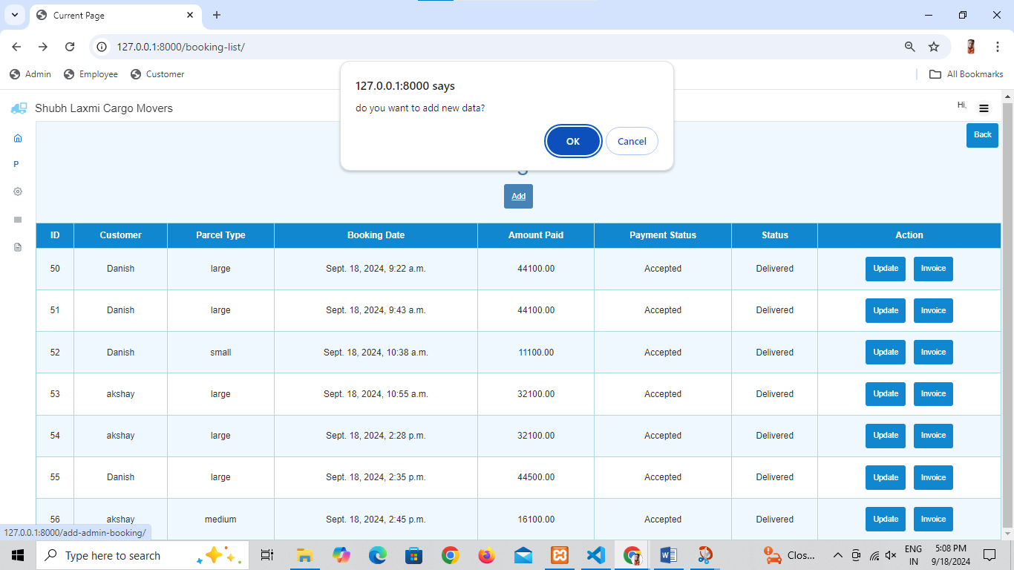

Slide 37
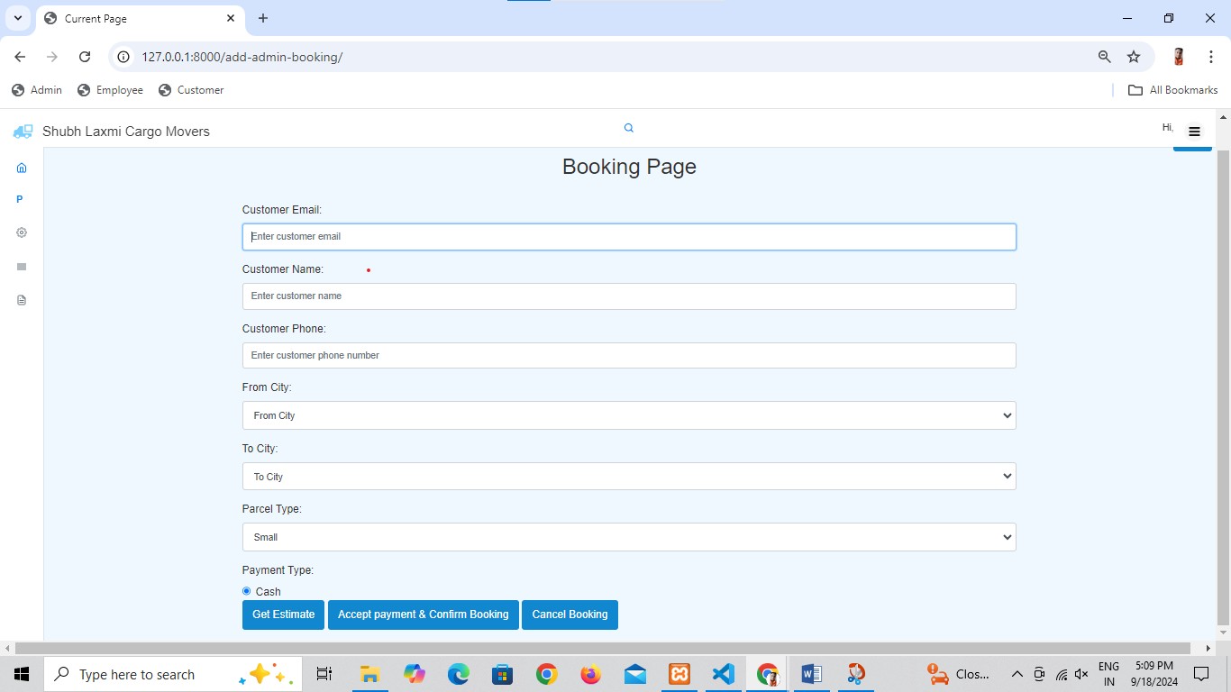

Slide 38
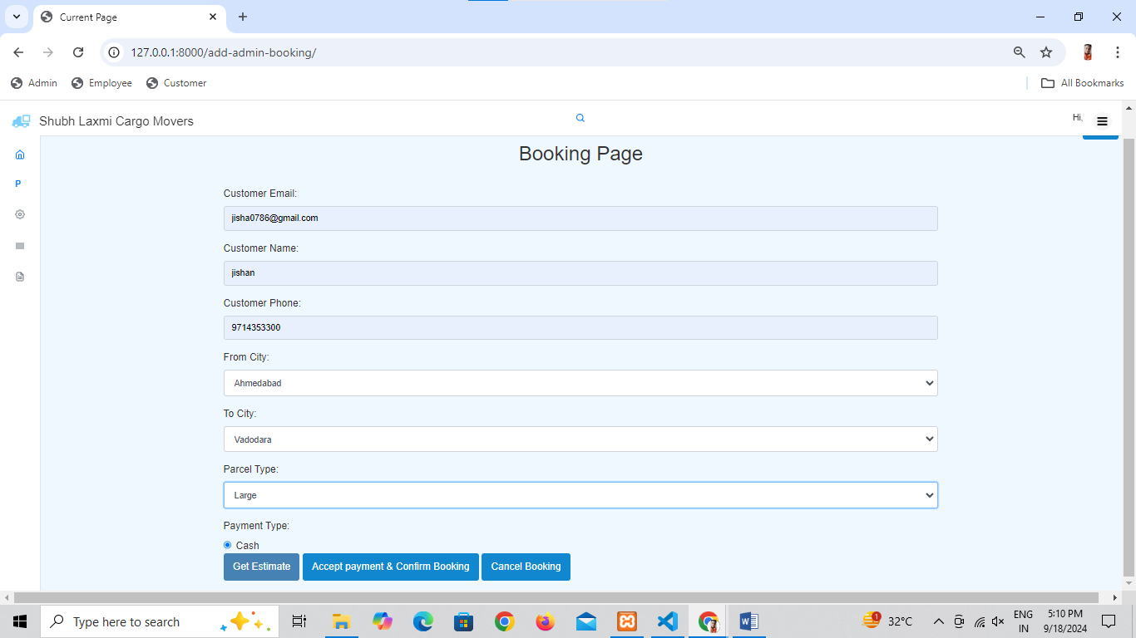

Slide 39
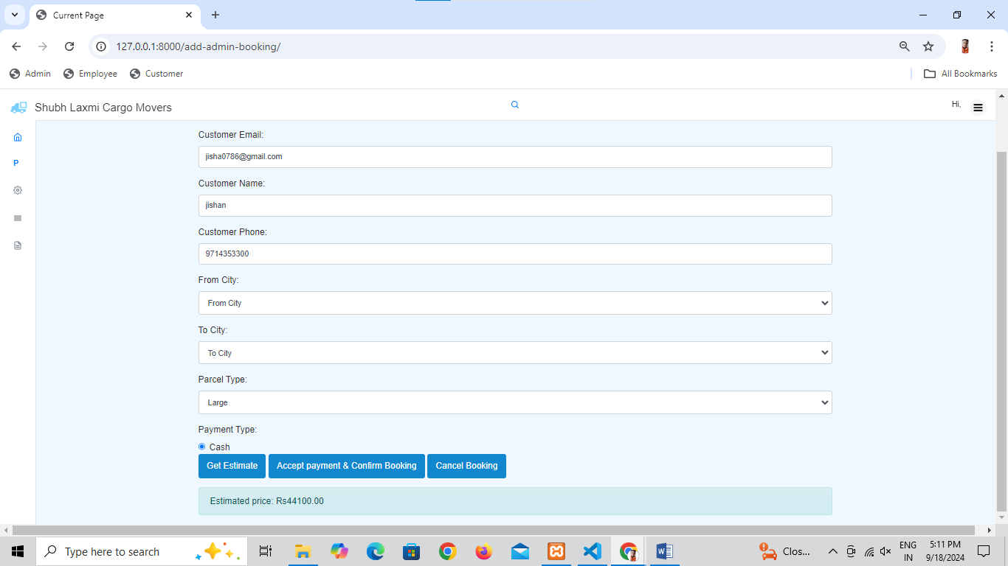

Slide 40
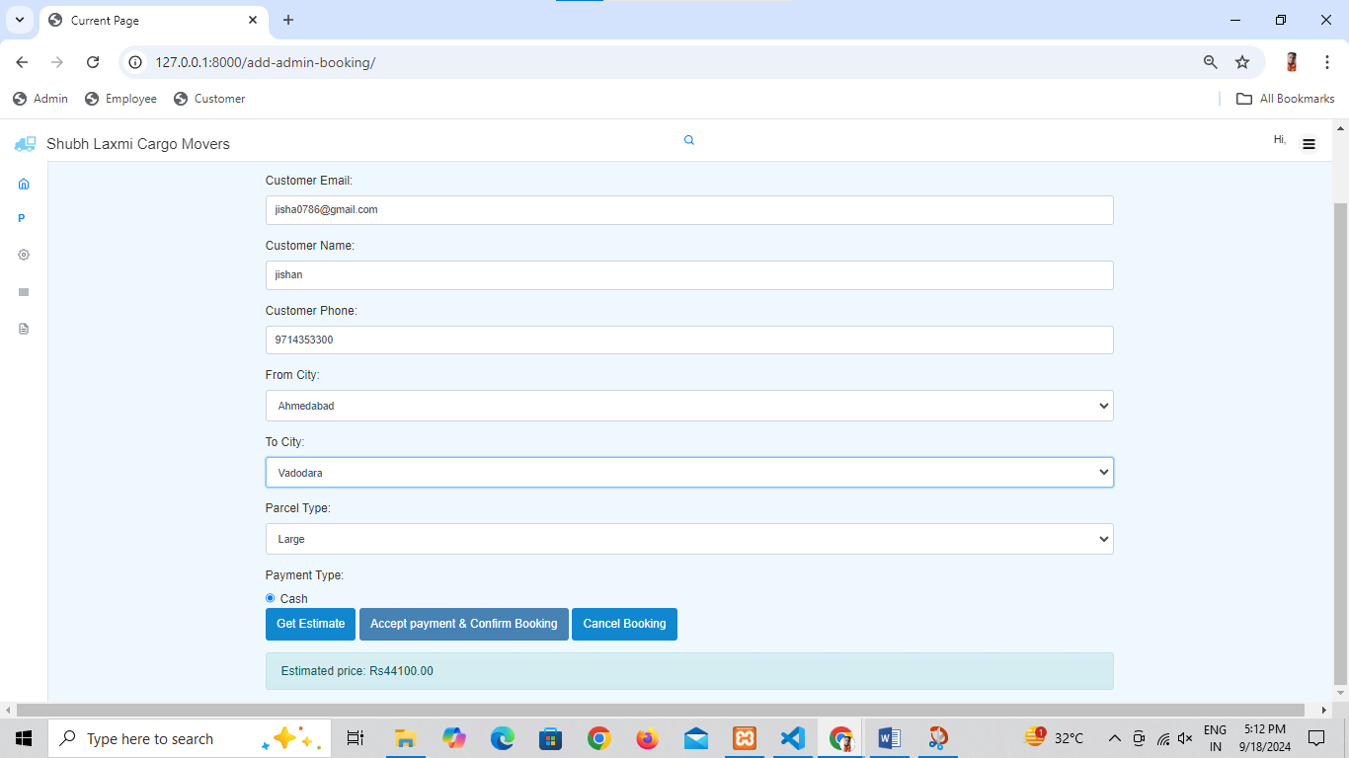

Slide 41
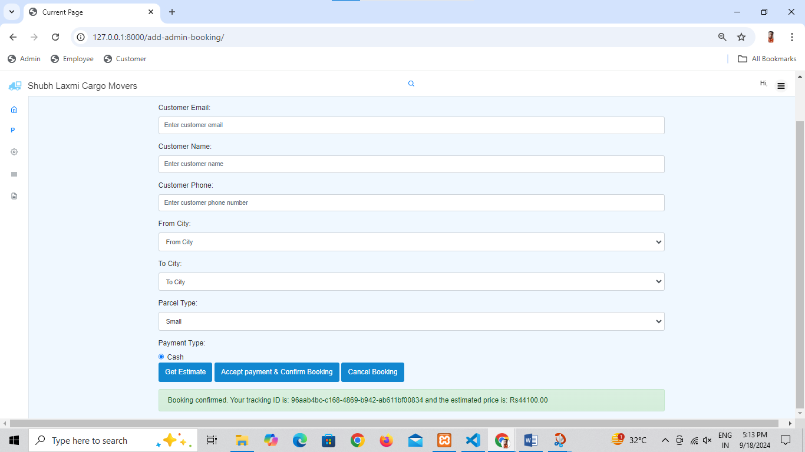

Slide 42
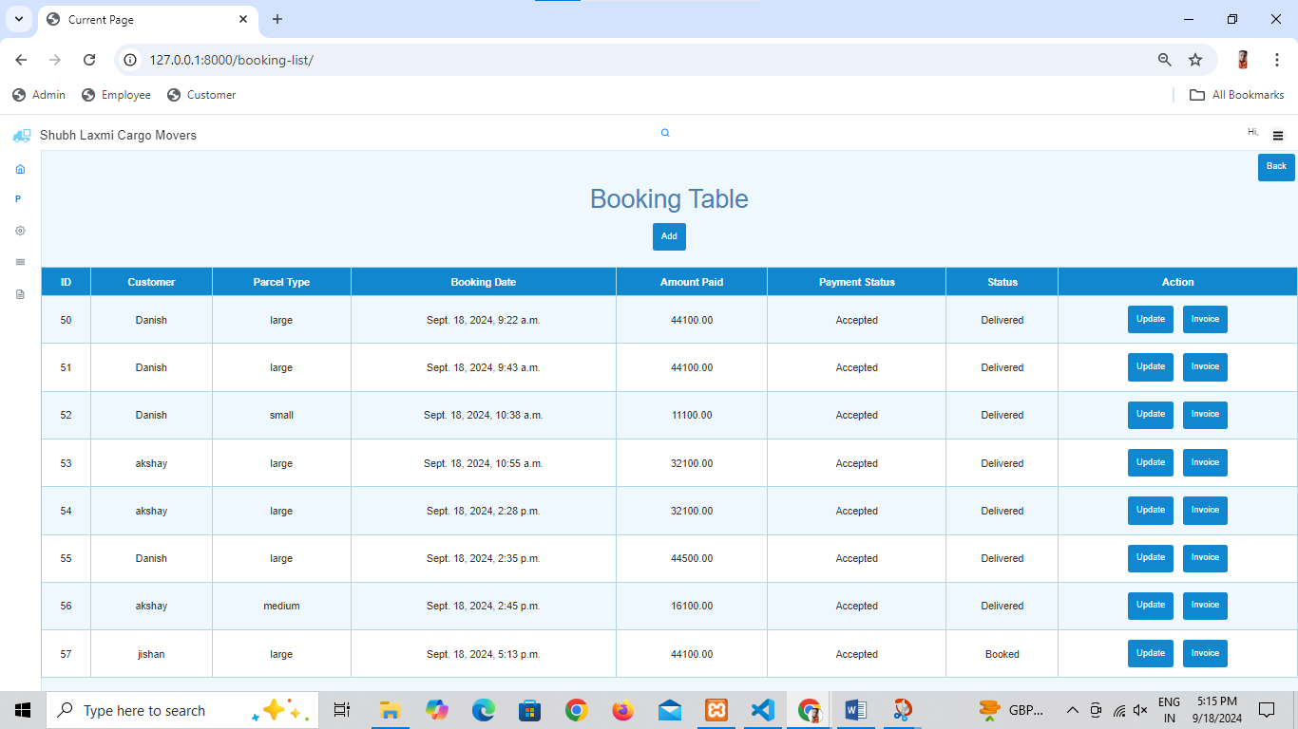

Slide 43
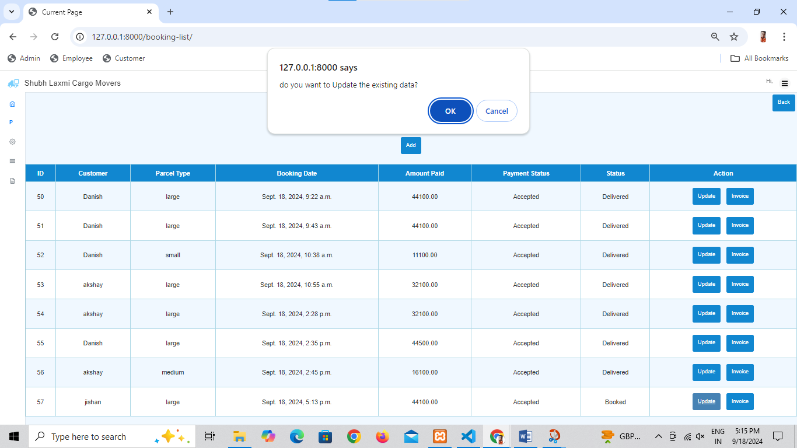

Slide 44
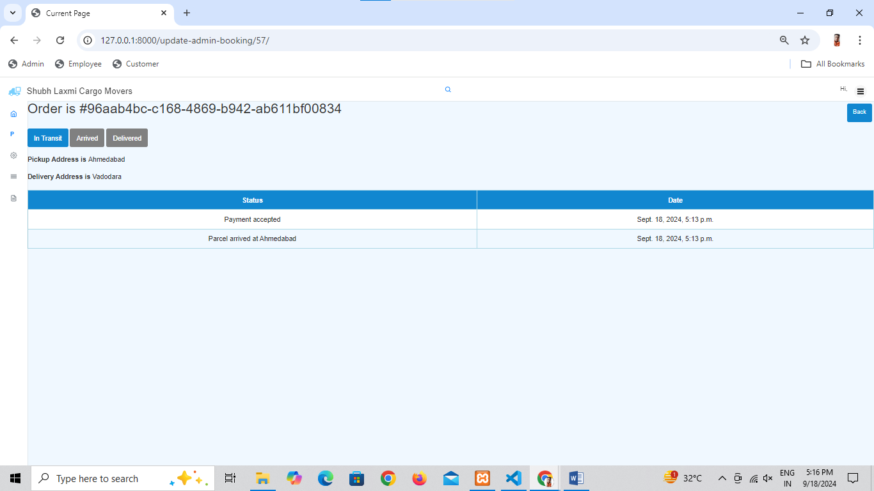

Slide 45
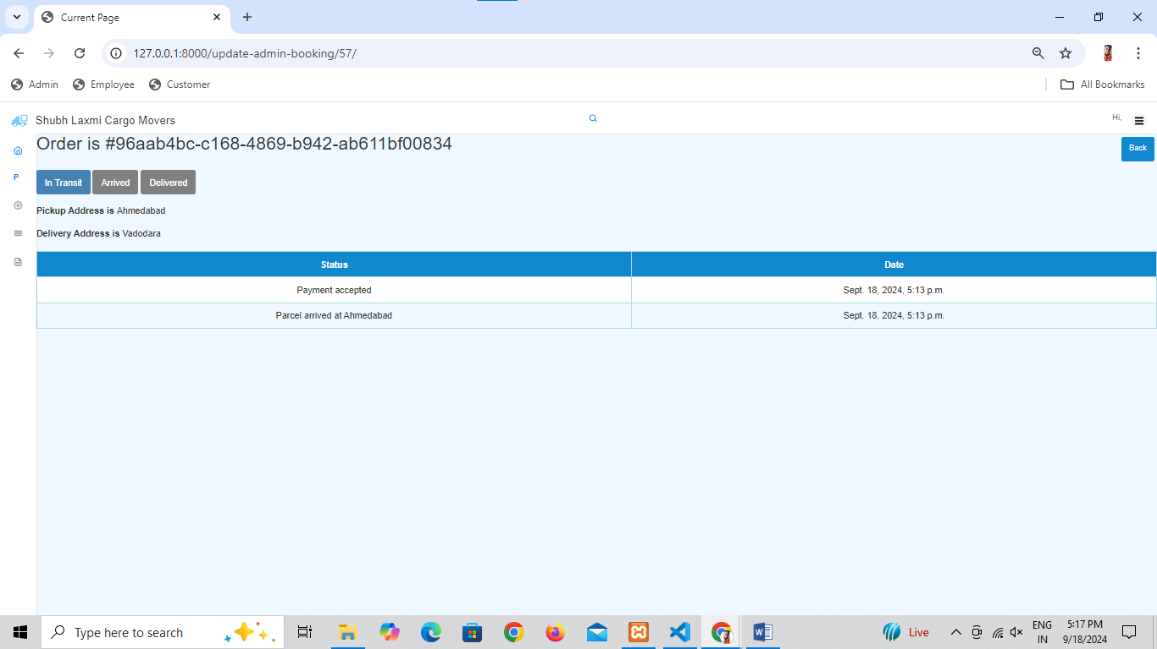

Slide 46
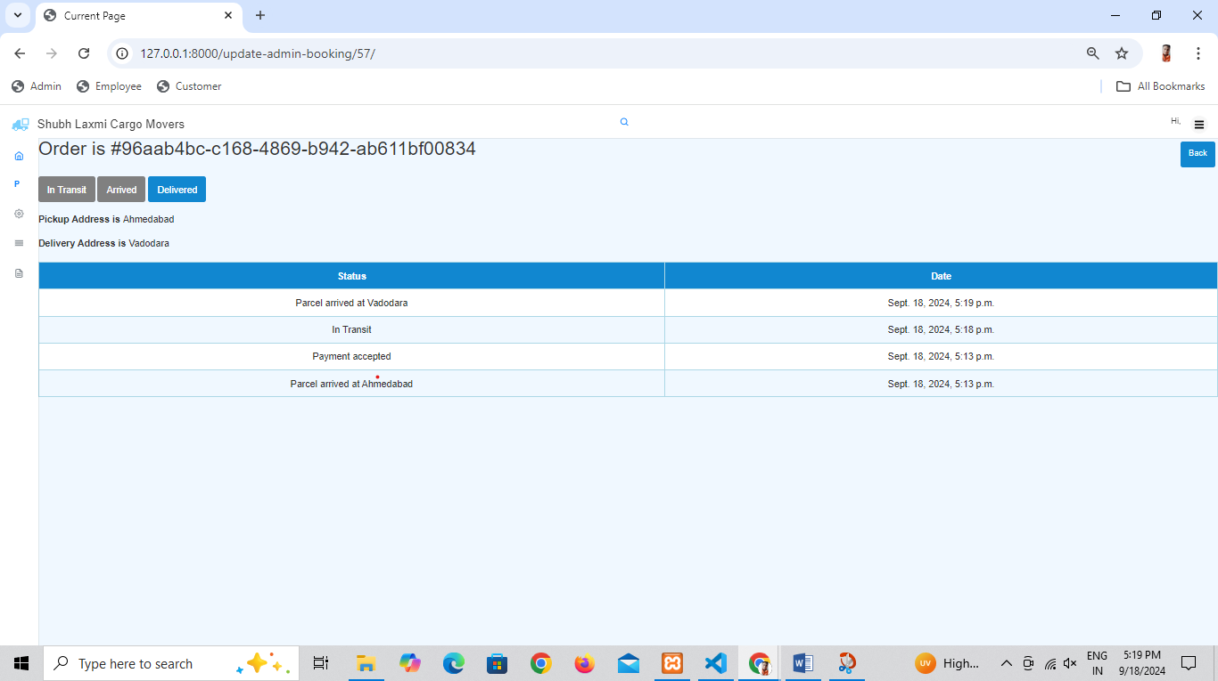

Slide 47
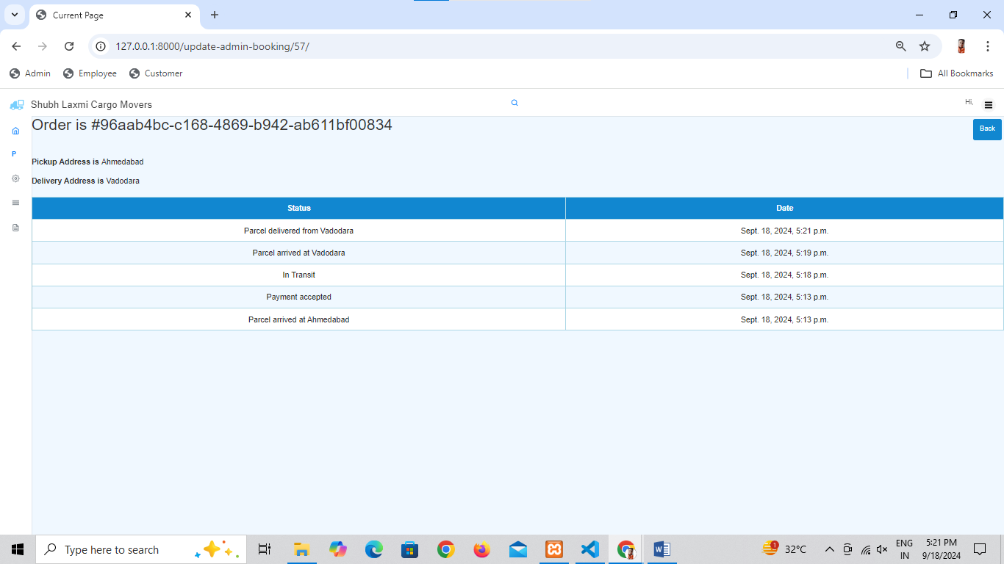

Slide 48


Slide 49
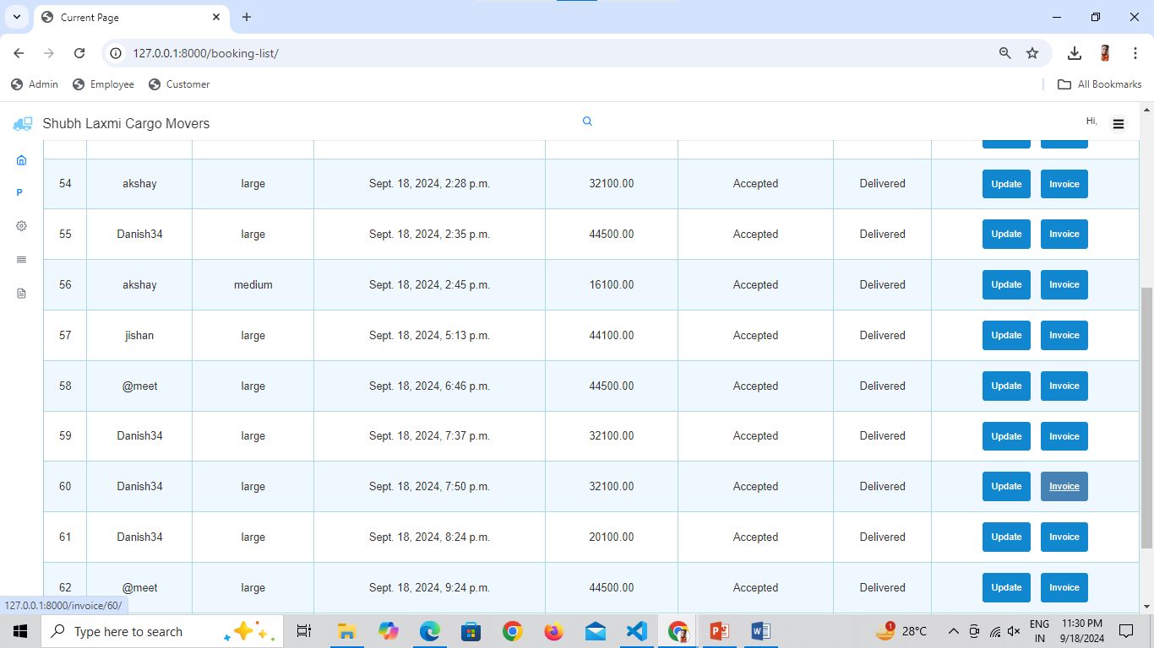

Slide 50
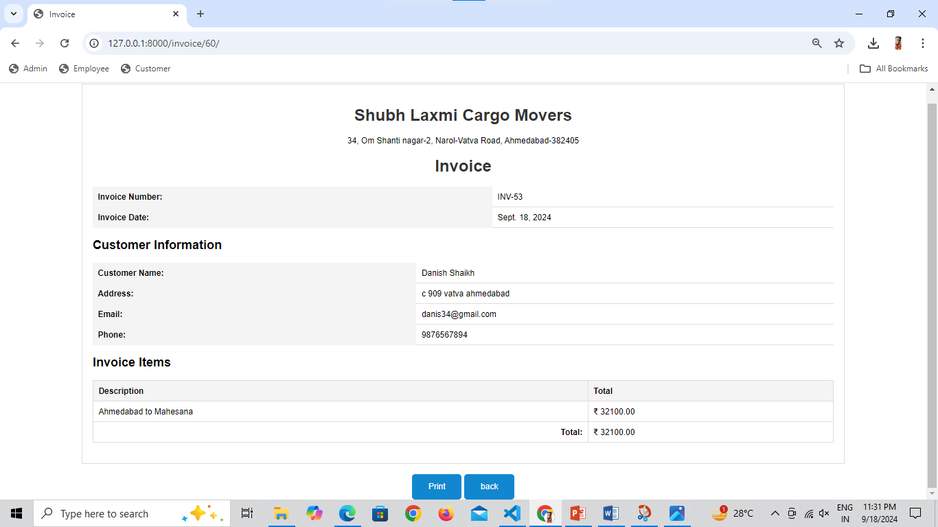

Slide 52
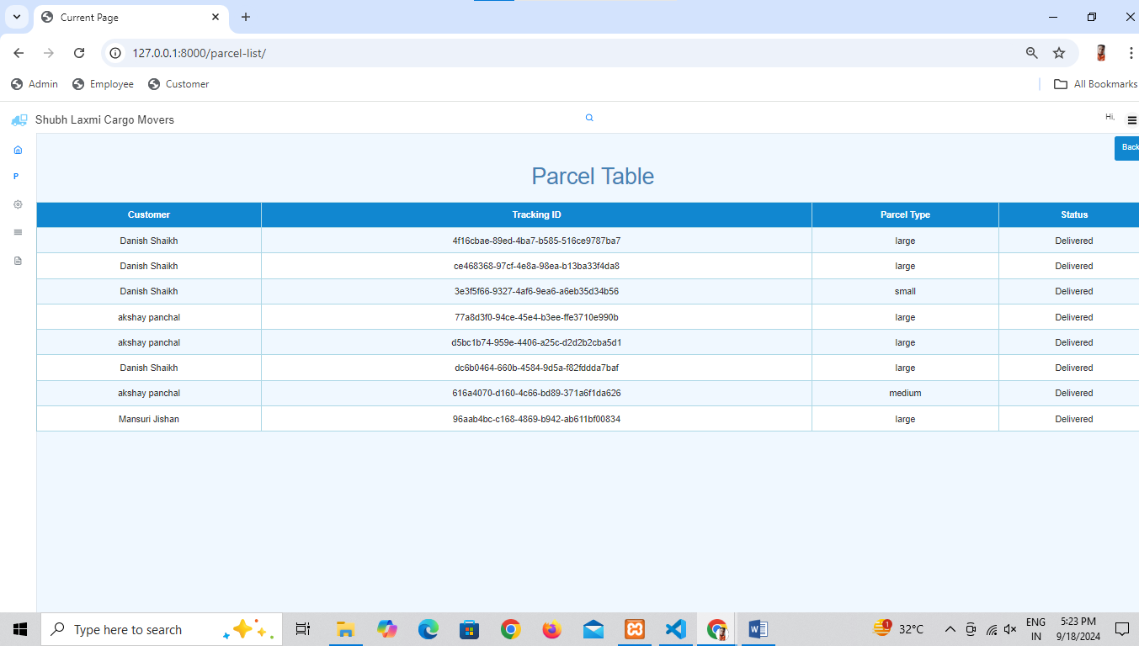

Slide 53
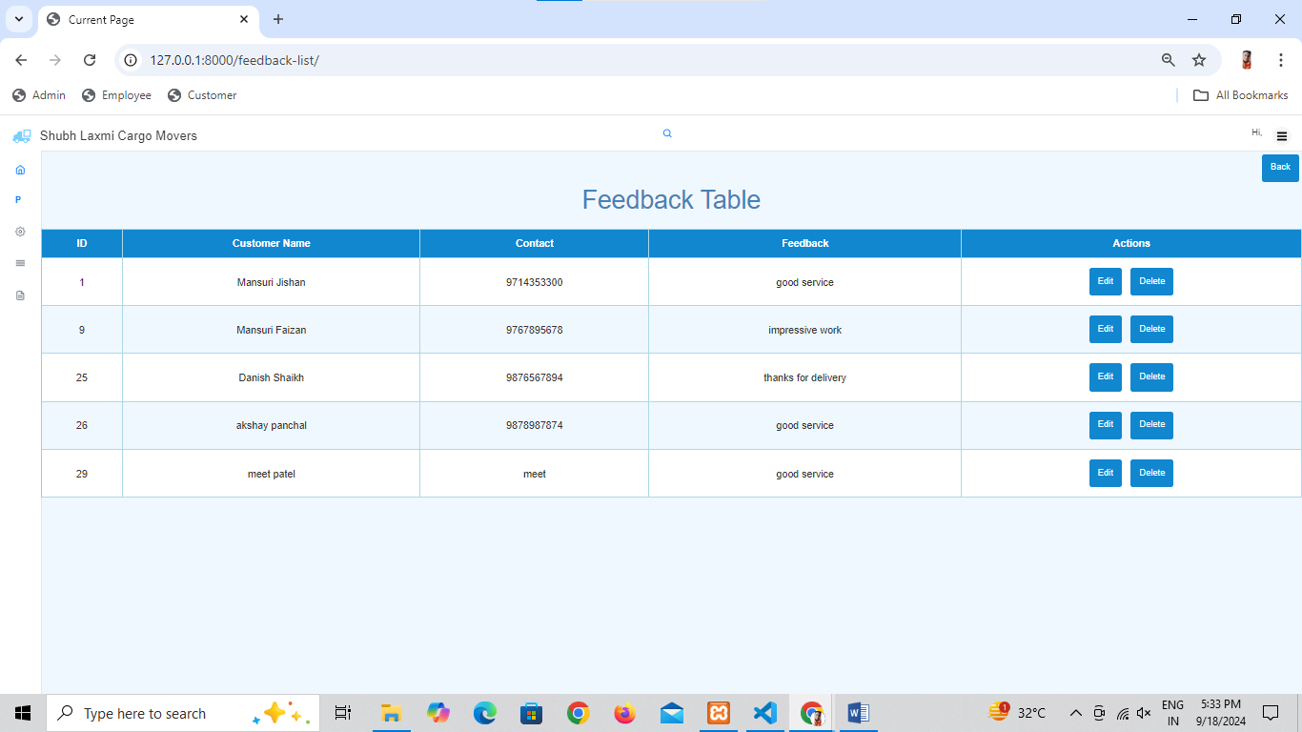

Slide 54
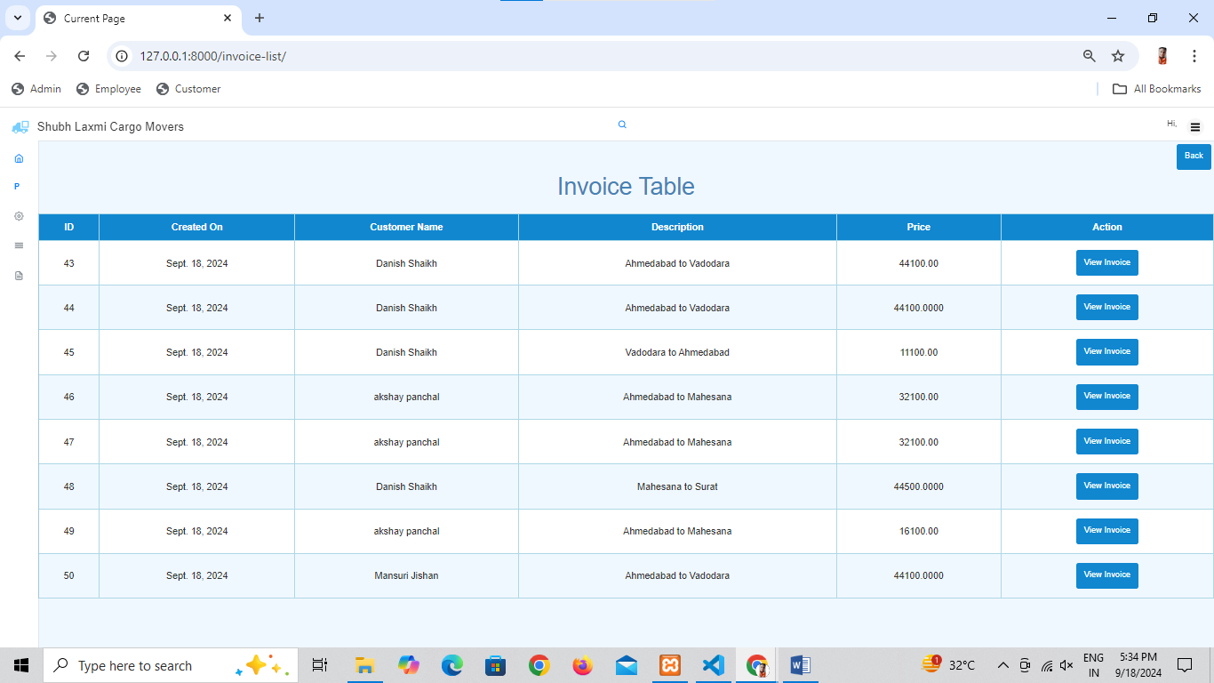

Slide 55
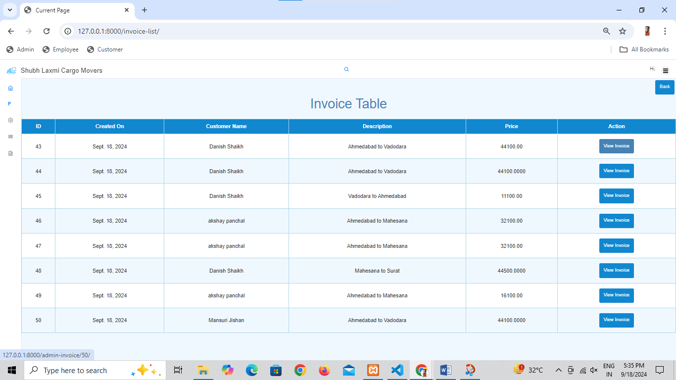

Slide 56
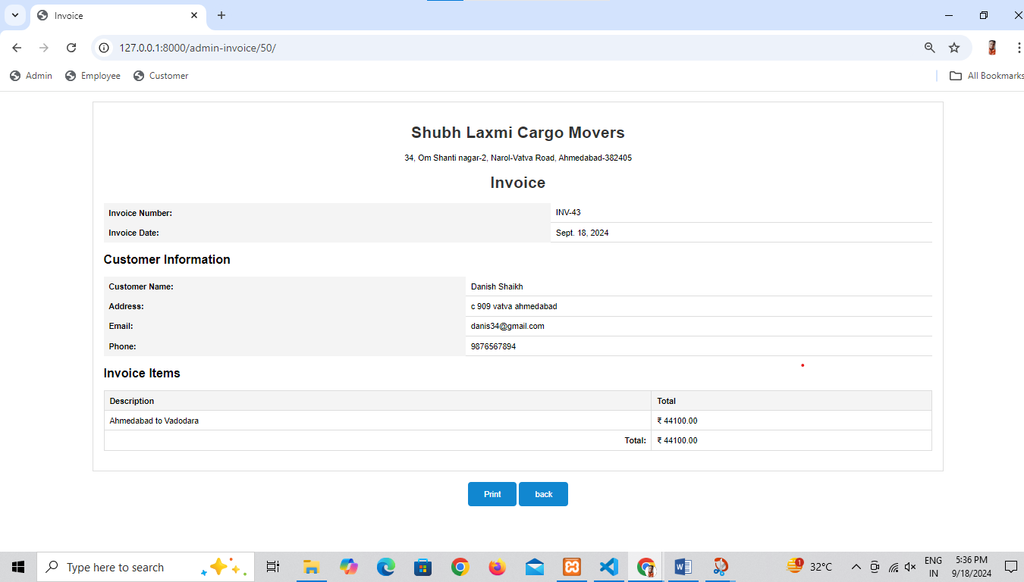

Slide 57
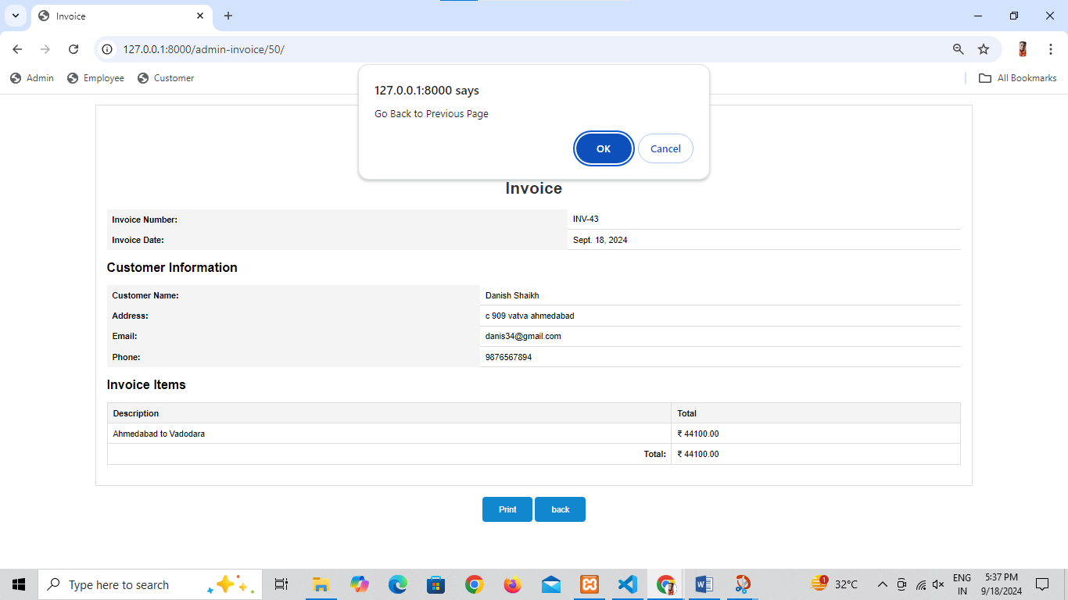

Slide 58


Slide 59
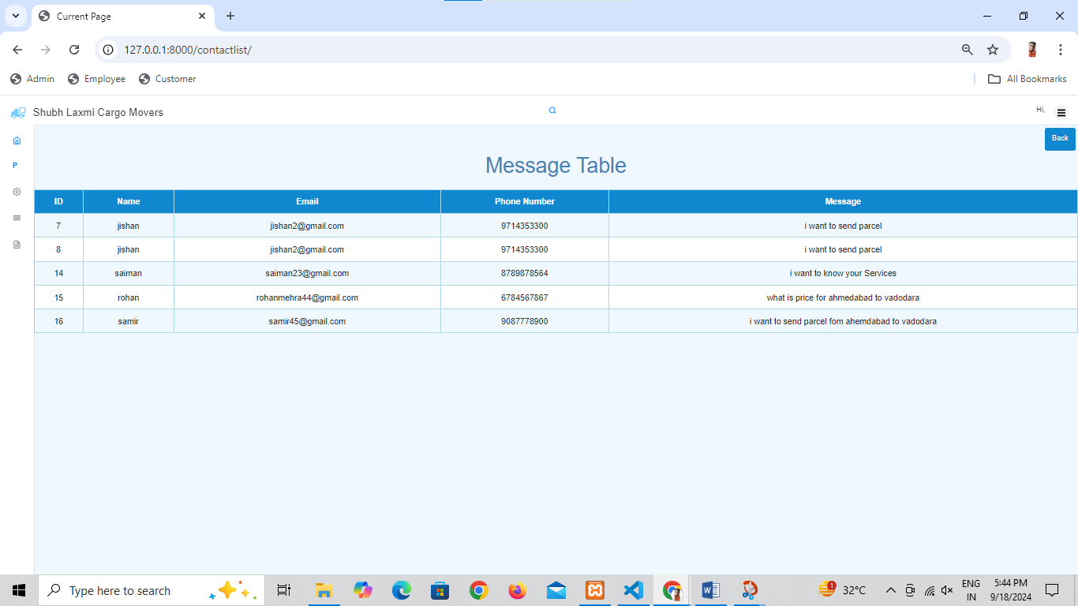

Slide 60
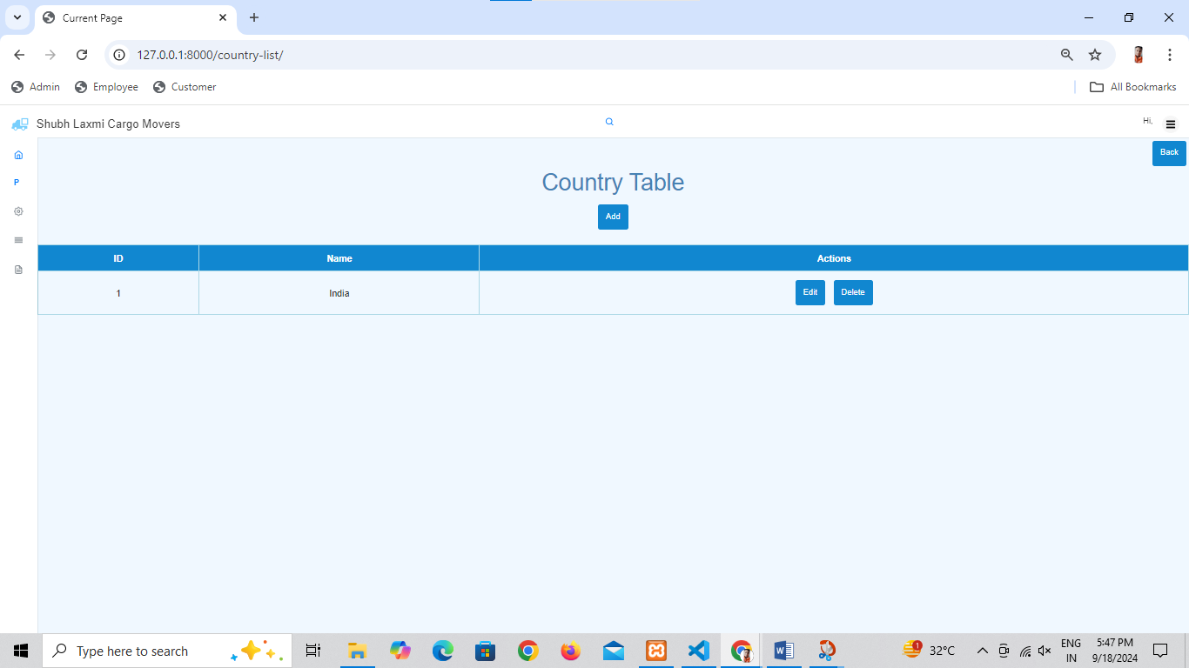

Slide 61
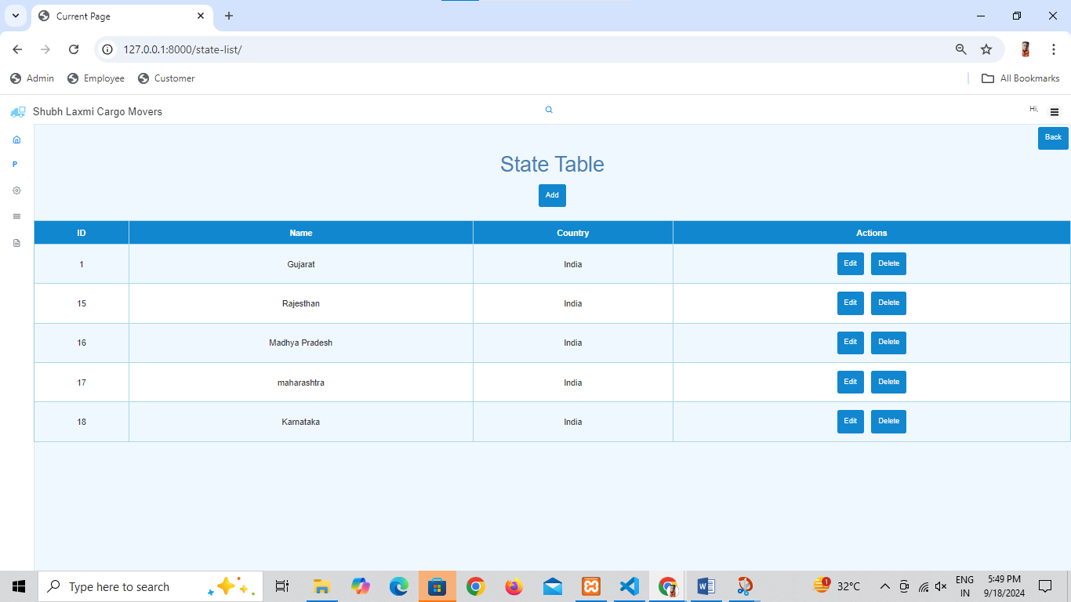

Slide 62
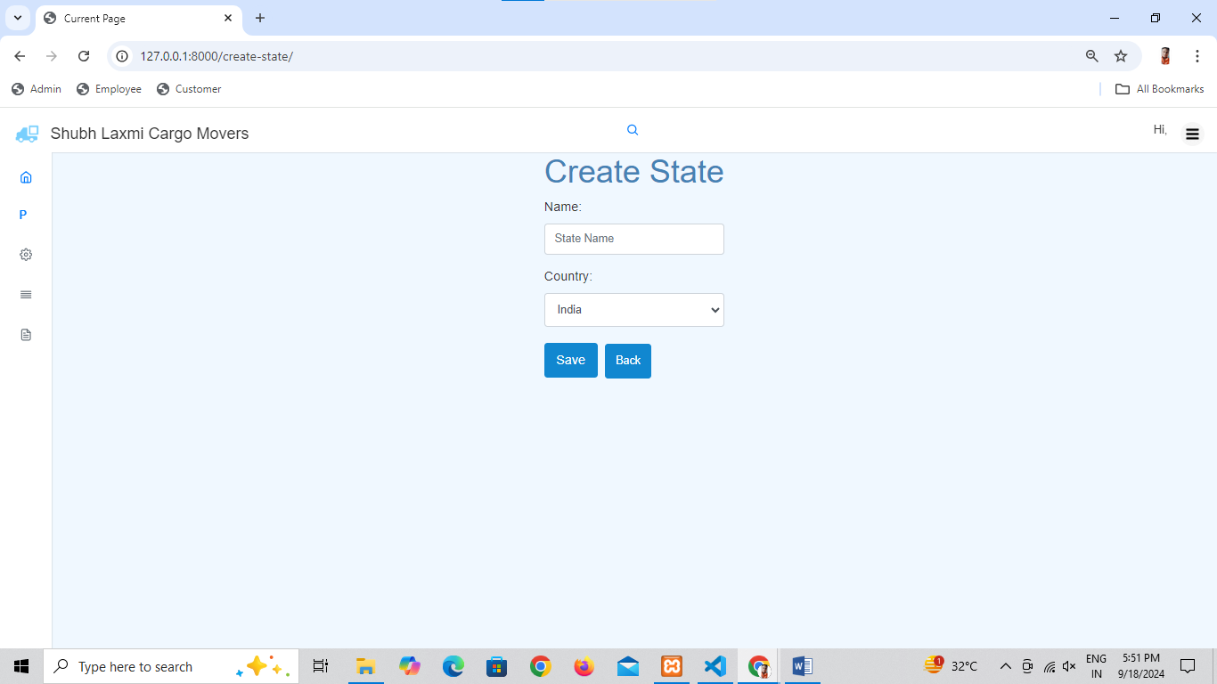
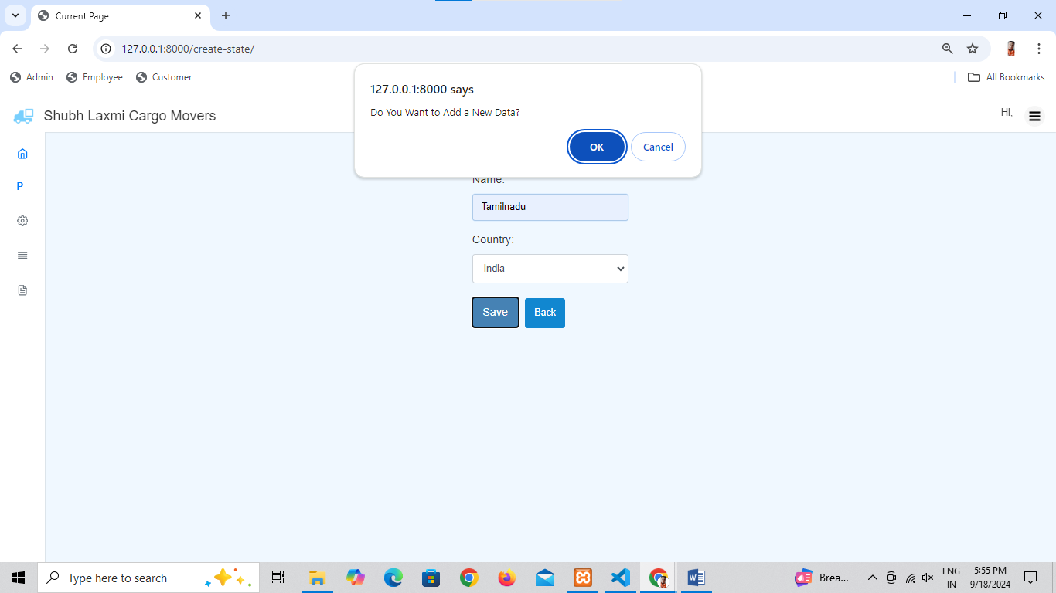

Slide 63
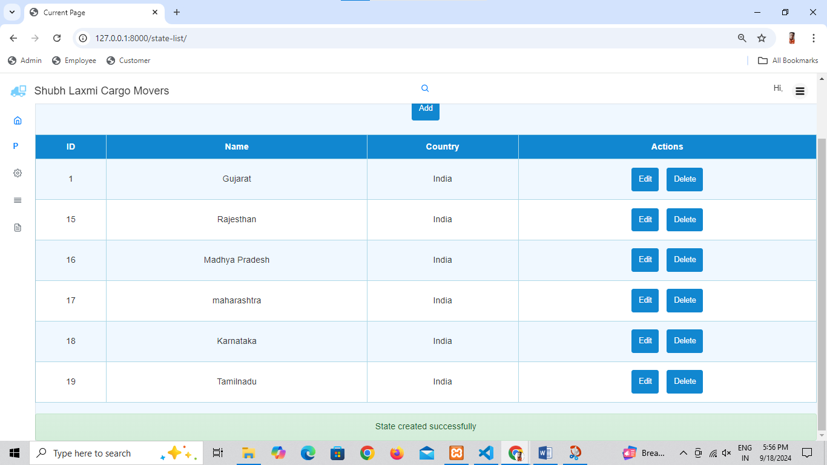

Slide 64
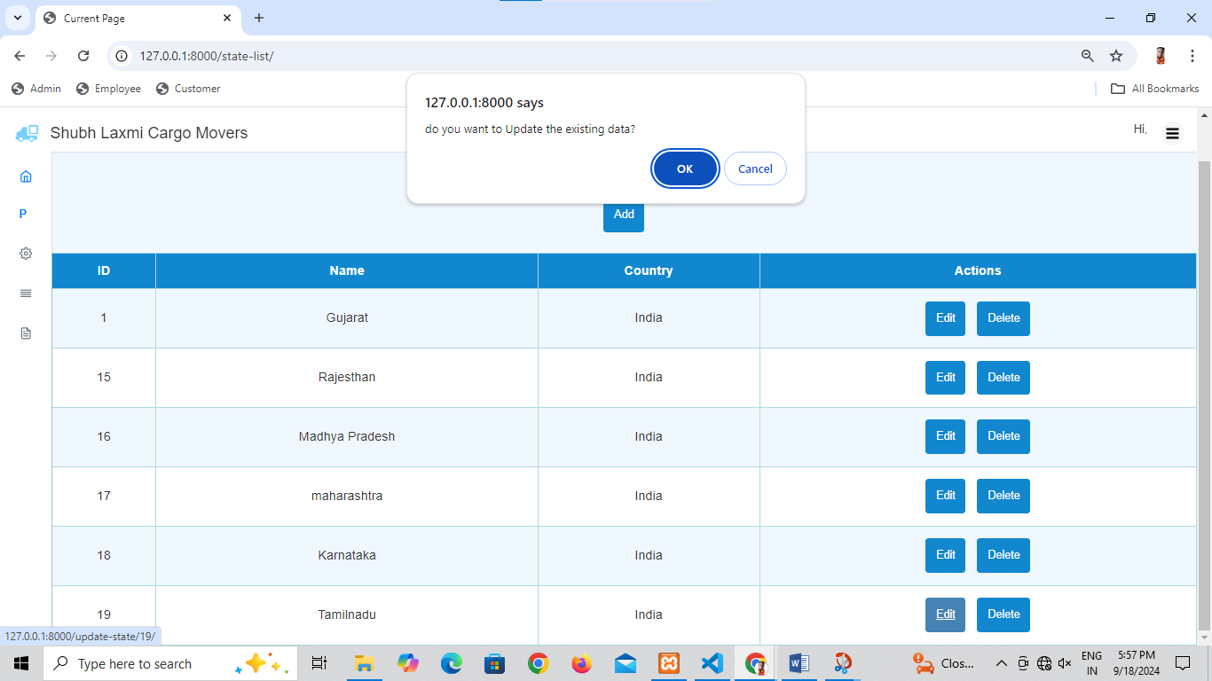

Slide 65
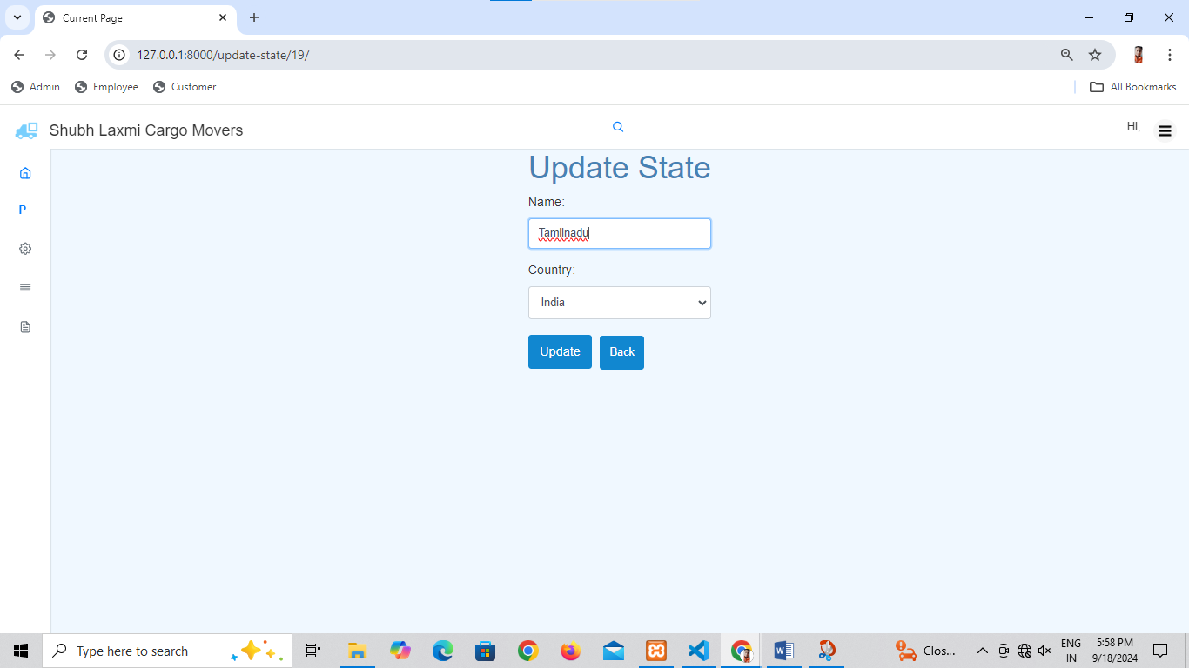

Slide 66


Slide 67


Slide 68


Slide 69


Slide 70


Slide 71


Slide 72


Slide 73


Slide 74


Slide 75


Slide 76



Slide 77


Slide 78


Slide 79


Slide 80


Slide 81


Slide 82


Slide 83


Slide 84


Slide 85


Slide 86


Slide 87


Slide 88


Slide 89


Slide 90


Slide 91


Slide 92


Slide 93


Slide 94


Slide 95


Slide 96


Slide 97


Slide 98


Slide 99
EMPLOYEE SIDE :

Slide 100


Slide 101


Slide 102


Slide 103


Slide 104


Slide 105


Slide 106


Slide 107


Slide 108


Slide 109


Slide 110


Slide 111


Slide 112


Slide 113


Slide 114


Slide 115


Slide 116


Slide 117


Slide 118


Slide 119


Slide 120


Slide 121


Slide 122


Slide 123


Slide 124


Slide 125


Slide 126


Slide 127


Slide 128


Slide 129


Slide 130


Slide 131


Slide 132


Slide 133


Slide 134


Slide 135


Slide 136


Slide 137


Slide 138


Slide 139


Slide 140
VISITOR SIDE :

Slide 141


Slide 142


Slide 143


Slide 144


Slide 145


Slide 146


Slide 147


Slide 148


Slide 149


Slide 150


Slide 151


Slide 152


Slide 153


Slide 154


Slide 155
CUSTOMER SIDE :

Slide 156


Slide 157



Slide 158


Slide 159


Slide 160


Slide 161


Slide 162


Slide 163


Slide 164


Slide 165


Slide 166


Slide 167


Slide 168


Slide 169


Slide 170


Slide 171


Slide 172


Slide 173



Slide 174


Slide 175


Slide 176


Slide 177


Slide 178


Slide 179


Slide 180


Slide 181


Slide 182


Slide 183


Slide 184


Slide 185
REPORTS LAYOUTS:

Slide 186


Slide 187


Slide 188


Slide 189


Slide 190


Slide 191


Slide 192


Slide 193



Slide 194


Slide 195


Slide 196


Slide 197


Slide 198
CONCLUSION :
It is our online cargo management system offers a seamless experience for customers looking to arrange any type of transport quickly and efficiently.
The key advantage of our platform is its time-saving capability, allowing users to book transportation services in just a minute. Our project simplify transportation needs of customers ,Transportation more accessible and efficient.

Slide 199
BIBLIOGRAPHY :
https://www.djangoproject.com/
https://chat.openai.com/
https:/www.youtube.com/
https://stackoverflow.com/

Slide 200
THANK YOU

